Slide 1


TOPIC: E-mail, Social Networking and e-Governance Services
COURSE: CCC Concepts
CHAPTER: E-mail, Social Networking and e-Governance Services
DAY: 36
Presentation By: Shruti Dubey

Slide 2
INTRODUCTION
Email
Electronic mail (email or e-mail) is a method of exchanging messages ("mail") between people using electronic devices. Invented by Ray Tomlinson, email first entered limited use in the 1960s and by the mid-1970s had taken the form now recognized as email.
Social networking
Social networking is a web based communication media, which allows users to have conversations, share information and create contents. As an introduction to social networking sites people use social media to communicate with friends, family and to learn new things which interests them and which is entertaining.

Slide 3
e-Governance Services
Electronic governance or e-governance is the application
of information
and
communication
technology
(ICT) for
delivering government
services,
exchange
of information,
stand-alone
communication transactions,
integration
of various
systems between government
to citizen (G2C),
government-to- government-to-
business (G2B), government-to-government
(G2G),
employees (G2E) as well as back-office processes and interactions within the entire government framework. Through e-governance, government services are made available to citizens in a convenient, efficient, and transparent manner. The three main target groups that can be distinguished in governance concepts are government, citizens, and businesses/interest groups. In e-governance, there are no distinct boundaries.

Slide 4
OBJECTIVES
Reduce administrative tasks that take you away from selling and
interacting with customers and prospects. Some objectives: Include a link in every e-mail to an online form that allows customers and prospects to keep their contact information up to date. Use e- mail templates to save time designing messages.

Slide 5
STRUCTURE OF E-MAIL
An email has three basic parts. The first is the header, a set of lines containing information about the message's transportation, such as the sender's address, the recipient's address, or timestamps showing when the message was sent by intermediary servers to the transport agents (MTAs), which act as a mail sorting office. The header begins with the From line and is changed each time it passes through an intermediary server.
The message itself, made up of the two following elements:
the header fields, a set of lines describing the message's settings, such as the sender, the recipient, the date, etc.

Slide 6
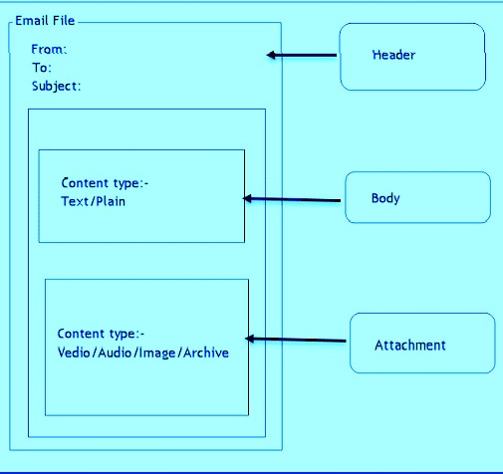
PICTORIALREPRESENTATION
An email includes at least the three following headers: From, showing the sender's email address; To, showing the recipient's email address; and Date, showing the date when the email was sent.

Slide 7
Using E-mails
Step 1
Open up your internet browser and pick an email program to use. The big ones are Gmail, Yahoo! and MSN Hotmail. Go to one of these websites and sign up for an email account. This usually involves picking a personal email address, choosing a password and entering some other information like your name or zip code.
Step 2
Gather email addresses of people you know and put them in your contacts list. Each email program should have a "Contacts" section, so click on that and start typing in email addresses. Having all your contacts in your email account will make it easier to write emails later--you won't have to manually type in the person's email address every time!

Slide 8
Step 3
To start using email, sign in with your email address and password from your email program's website. You can go to each email program's home page and then click "Email" or save the email sign- in webpage to your bookmarks. Once you've signed in, you'll see your inbox. This is where you'll see emails that people send you.
Step 4
To write an email, click the "Compose Mail" or "Write an Email" link. You'll see a page with a bunch of empty boxes on it. In the first box "To:" you'll put the person's email address you're sending the email to. Then choose a subject, and finally, write your email in the big box. When you're done, click send.

Slide 9
Step 5
You might want to send a mass email to all your contacts letting them know of your new email address. Each email program is slightly different in sending emails to multiple people. There should be a link to your contacts near the "To" box (Yahoo has a link called "Insert addresses.") You'll check a box next to each contact's name to add them to an email.
Step 6
In order to read emails that are sent to you, all you have to do is click on the email subject. If you want to send an email you received to someone else, this function is called "Forward." All you have to do is click the "Forward" button for most email programs and then click "Send.“
Step 7
You'll also see a "Trash" link in your email inbox. This is where you can put emails that you don't want to look at anymore. It's like the Trash option on your computer where you can delete files. Put emails you don't need anymore in the Trash, and empty the Trash when it gets too full.

Slide 10
(i) Opening Email Account
Sign in (Open Email Account)
On your computer, go to gmail.com.
Enter your Google Account email or phone number and password.
If information is already filled in and you need to sign in to a different account, click Use another account.
If you see a page describing Gmail instead of the sign-in page, click Sign in in the top right corner of the page.

Slide 11
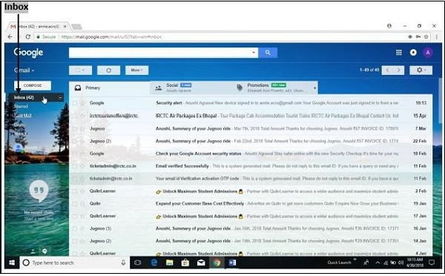
(ii) Mailbox: Inbox and Outbox
Inbox − Inbox is an area where you can see all the received mails.
Outbox − Outbox is an area where the outgoing messages or messages which are in process of sending or which are failed to send are stored.

Slide 12
Thank you!
www.nielit.gov.in/haridwar

